Slide 1
8.3: Systems of Linear Equations and Matrices
MATH 1550 - Precalculus

Slide 2
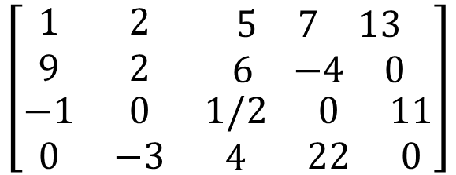
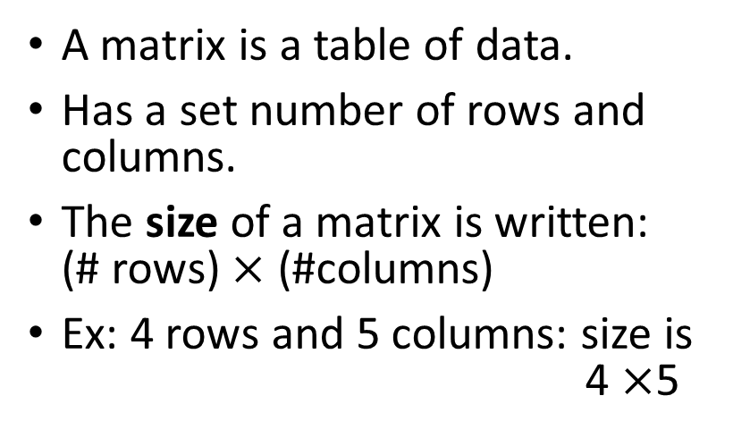
Matrices
columns
A matrix is a table of data.
Has a set number of rows and columns.
The size of a matrix is written: (# rows) $×$ (#columns)
Ex: 4 rows and 5 columns: size is 4 $×$5
$$\left[\begin{matrix}1 & 2 & \begin{matrix}5 & 7 & 13\end{matrix} \\ 9 & 2 & \begin{matrix}6 & −4 & 0\end{matrix} \\ \begin{matrix}−1 \\ 0\end{matrix} & \begin{matrix}0 \\ −3\end{matrix} & \begin{matrix}\begin{matrix}1/2 \\ 4\end{matrix} & \begin{matrix}0 \\ 22\end{matrix} & \begin{matrix}11 \\ 0\end{matrix}\end{matrix}\end{matrix}\right]$$
rows

Slide 3

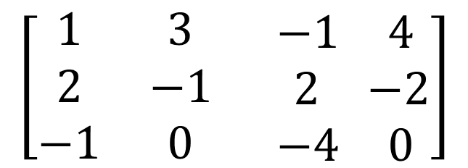



Augmented Matrices
$$\left\{\begin{aligned}x+3y−z=4 \\ 2x−y+2z=−2 \\ −x −4z=0\end{aligned}\right.$$
$$x$$
$$y$$
$$z$$
Consider :
It is easier to simply consider the coefficients of the system. We may place them in a matrix called an augmented matrix:
$$\left[\begin{matrix}1 & 3 & \begin{matrix}−1 & 4\end{matrix} \\ 2 & −1 & \begin{matrix} 2 & −2\end{matrix} \\ −1 & 0 & \begin{matrix}−4 & 0\end{matrix}\end{matrix}\right]$$
We use a vertical line to denote the = signs in the system.

Slide 4
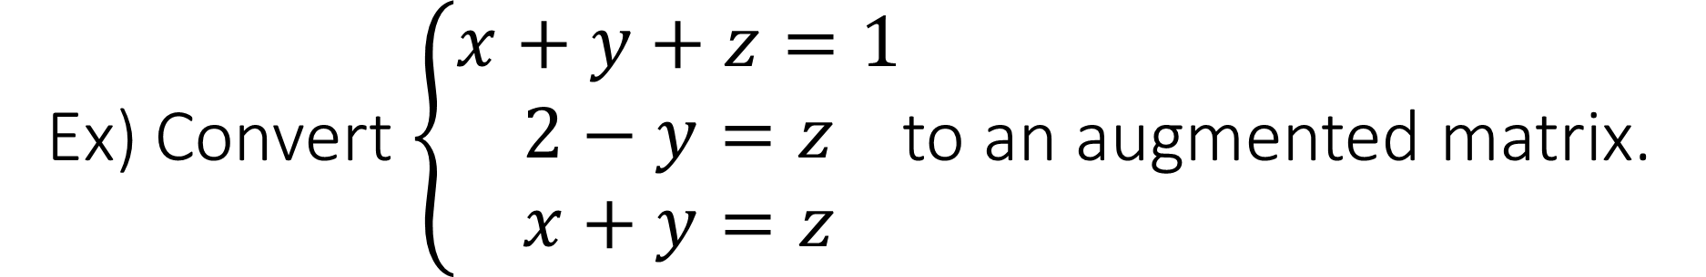
Ex) Convert $\left\{\begin{aligned}x+y+z=1 \\ 2−y=z \\ x+y=z\end{aligned}\right.$to an augmented matrix.

Slide 5
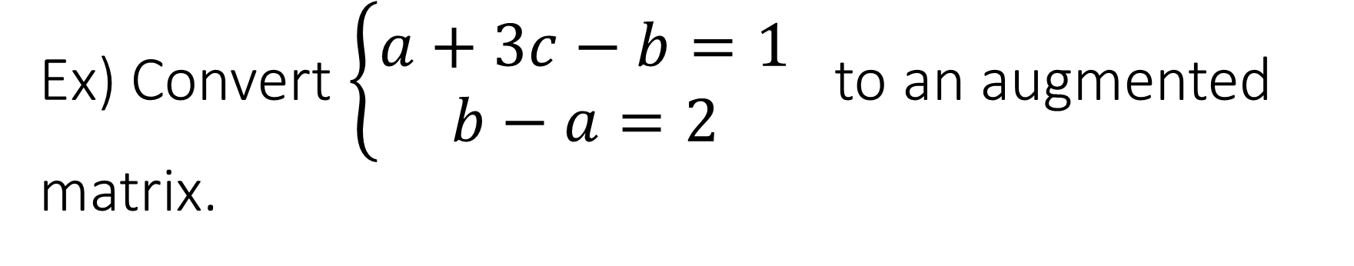
Ex) Convert $\left\{\begin{aligned}a+3c−b=1 \\ b−a=2\end{aligned}\right.$ to an augmented matrix.

Slide 6
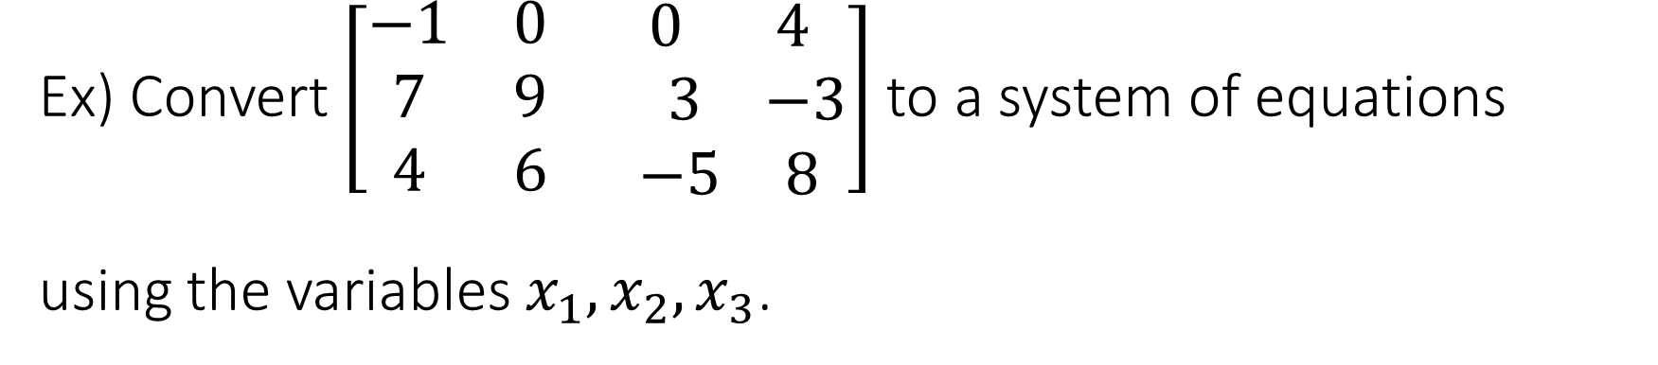
Ex) Convert $\left[\begin{matrix}−1 & 0 & \begin{matrix}0 & 4\end{matrix} \\ 7 & 9 & \begin{matrix} 3 & −3\end{matrix} \\ 4 & 6 & \begin{matrix}−5 & 8\end{matrix}\end{matrix}\right]$ to a system of equations using the variables $x_{1},x_{2},x_{3}$.

Slide 7

Row Operations on a Matrix
There are 3 common operations for matrices:
$R_{i}↔R_{j}$ (Interchange any two rows)
$kR_{i}→R_{i}$ (Multiply any row by a constant $k≠0$)
$kR_{i}+R_{j}→R_{j}$ (Add a multiple of one row to another row)

Slide 8
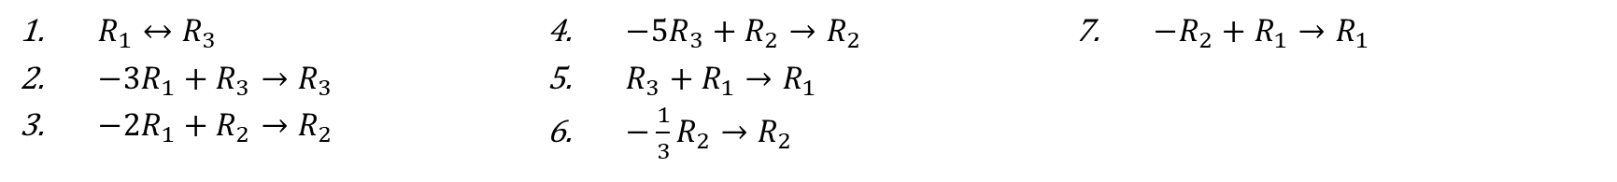
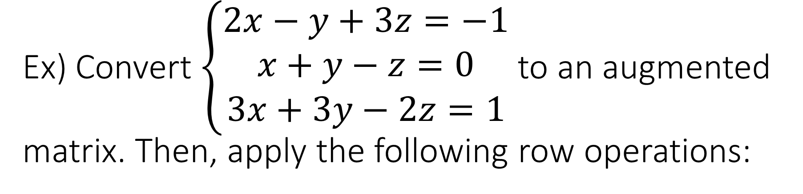
Ex) Convert $\left\{\begin{aligned}2x−y+3z=−1 \\ x+y−z=0 \\ 3x+3y−2z=1\end{aligned}\right.$to an augmented matrix. Then, apply the following row operations:
$R_{1}↔R_{3}$
${−3R}_{1}+R_{3}→R_{3}$
${−2R}_{1}+R_{2}→R_{2}$
${−5R}_{3}+R_{2}→R_{2}$
$R_{3}+R_{1}→R_{1}$
$−\frac{1}{3}R_{2}→R_{2}$
$−R_{2}+R_{1}→R_{1}$

Slide 9
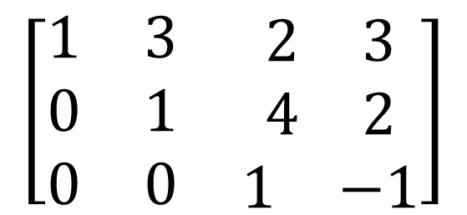

Row-Echelon Form
Row-Echelon form is in essence a “stairstep pattern” of 1’s and 0’s in the augmented matrix.
To obtain RE-form, for the $k^{th}$ row, try to get a 1 in the $k^{th}$column, and make everything below zero using row operations.
$$\left[\begin{matrix}1 & 3 & \begin{matrix}2 & 3\end{matrix} \\ 0 & 1 & \begin{matrix}4 & 2\end{matrix} \\ 0 & 0 & \begin{matrix}1 & −1\end{matrix}\end{matrix}\right]$$

Slide 10
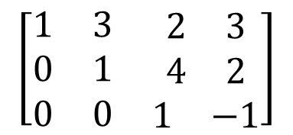

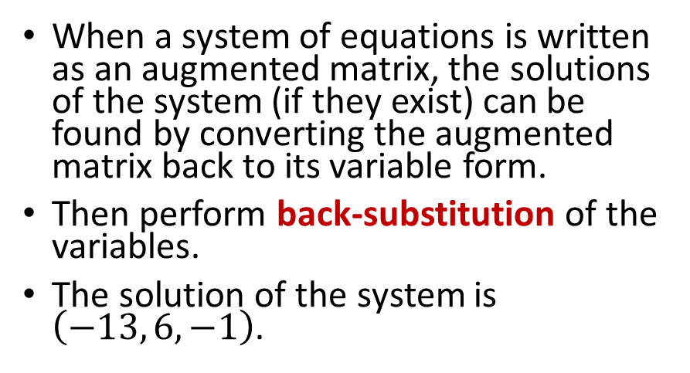


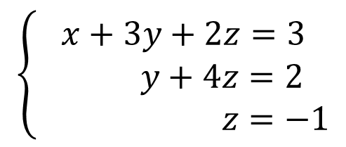
Why is Row-Echelon Form Useful?
When a system of equations is written as an augmented matrix, the solutions of the system (if they exist) can be found by converting the augmented matrix back to its variable form.
Then perform back-substitution of the variables.
The solution of the system is $\left(−13, 6,−1\right)$.
$$x$$
$$y$$
$$z$$
$$\left[\begin{matrix}1 & 3 & \begin{matrix}2 & 3\end{matrix} \\ 0 & 1 & \begin{matrix}4 & 2\end{matrix} \\ 0 & 0 & \begin{matrix}1 & −1\end{matrix}\end{matrix}\right]$$
$$\left\{\begin{aligned}x+3y+2z=3 \\ y+4z=2 \\ z=−1\end{aligned}\right.$$

Slide 11

Gaussian Elimination
Ex) Solve $\left\{\begin{aligned}2x +y =−8 \\ x+3y =6\end{aligned}\right.$ using Gaussian Elimination
Ex) Solve $\left\{\begin{aligned}x+2y =4 \\ 2x+3y=2\end{aligned}\right.$ using Gaussian Elimination

